Slide 1
RAM and Layout techniques
September 23, 2016
TuongPV

Slide 2
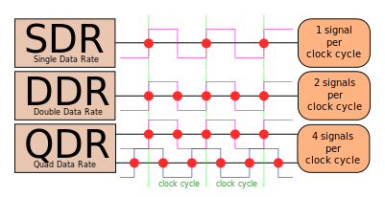
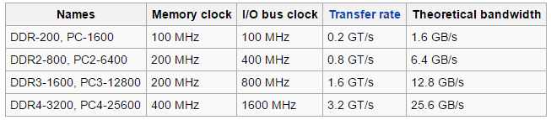
SDRAM
Synchronous Dynamic Random-Access memory
DDRx : Double Data Rate
Transfer data on both rising and falling edges o clock signal.
(Source: Wikipedia)
1

Slide 3
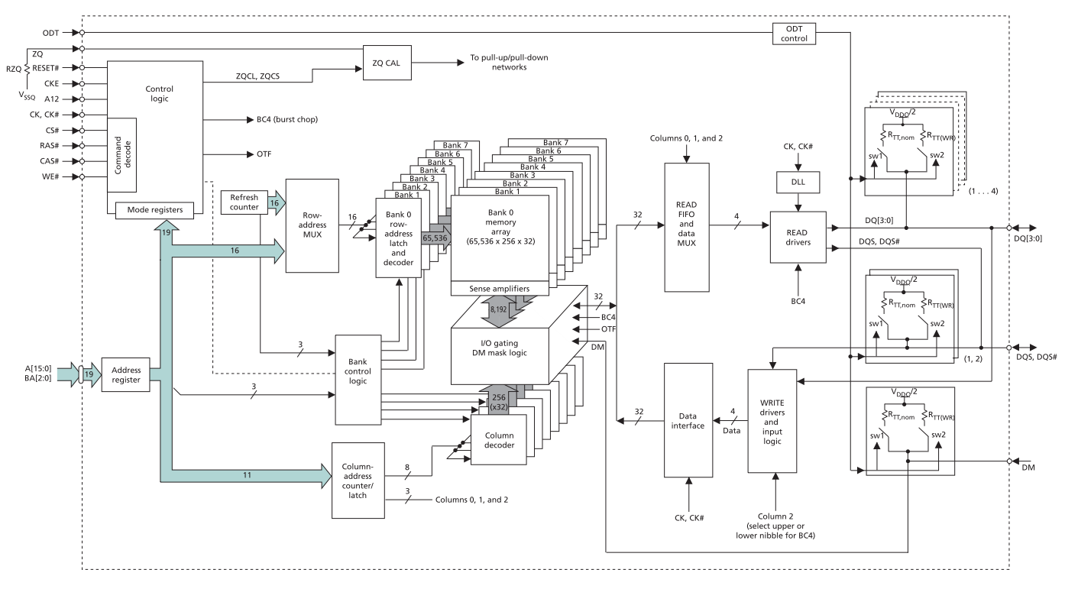
SDRAM Block diagram
2

Slide 4
SDRAM signal groups
Address
Clock
Data
3

Slide 5
Pin swap
Data pins can be swapped with each byte

Slide 6
Connection
TI Pin Mux (http://www.ti.com/tool/PINMUXTOOL)
Recommends

Slide 7
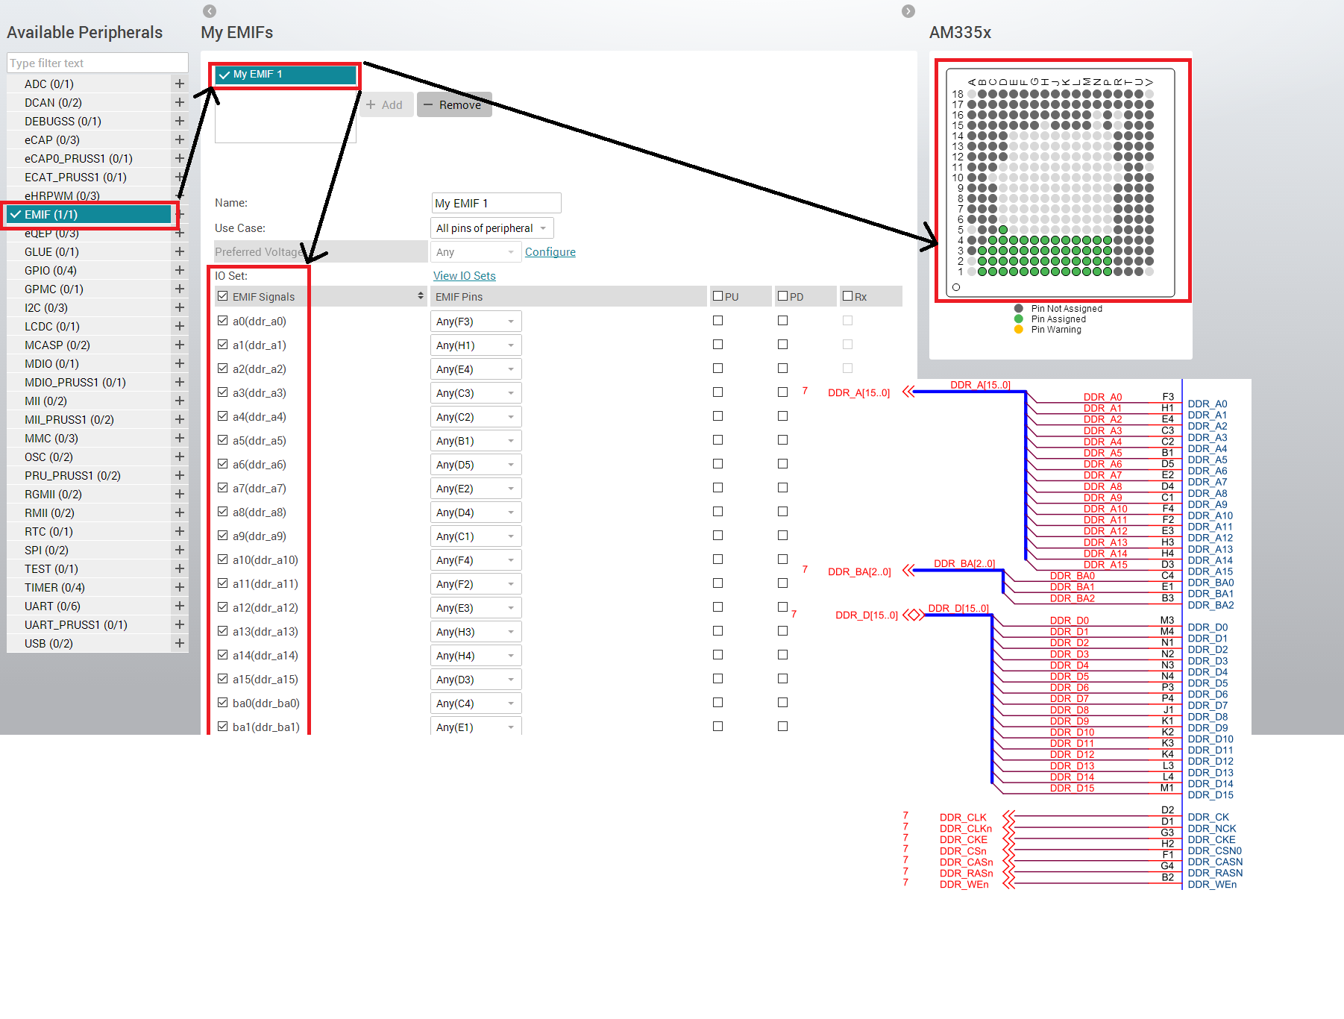

Slide 8
Layout topology
Fly-by
T-point

Slide 9
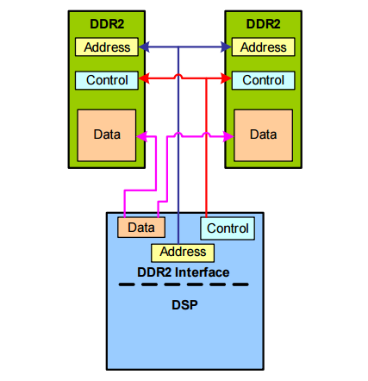
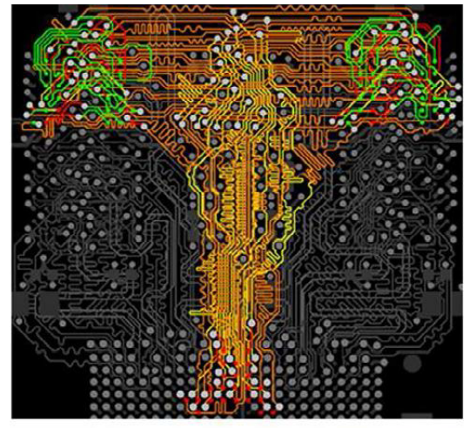
Layout topology
T-point

Slide 10
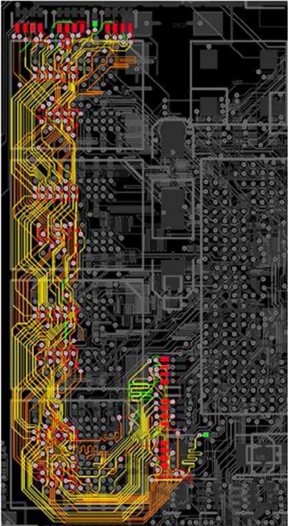
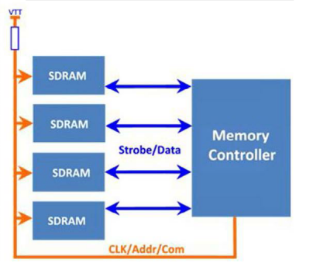
Layout topology
Fly-by

Slide 11
Pros and Cons
 | Pros | Cons
Fly-by | Easy to route Support higher-freq Reduce length of stubs Improve signal integrity | -Not work well with high load
T-branch | Delivery better system margin Be advantageous when using multi die with high cap. load Suitable for DDR2 | Challenging to route (but…)

Slide 12

Open-Rex

